Slide 1
Unemployment, Mental Distress and Violent Crime

Slide 2

Overview
Background
01
Objectives of Analysis
02
Methods/
story
03
Results
04
Discussion
05

Slide 3
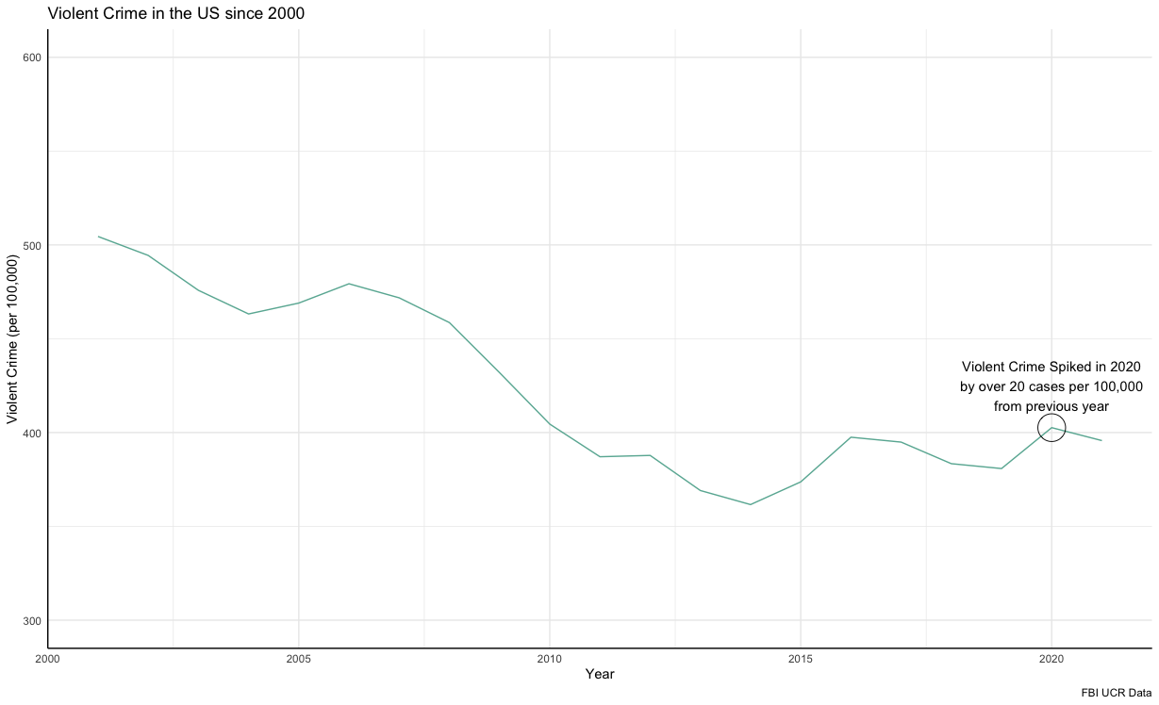
Background
Violent Crime rates nationally spiked in 2020
Largely driven by homicides
Wanted to see pre-pandemic relationships

Slide 4

Objectives
Primary Objective
Analyze the associations between a city's Unemployment percentage and its Violent Crime rate.
Secondary Objective
Analyze the associations between a city’s percentage of adults experiencing mental distress and Violent Crime rate.

Slide 5
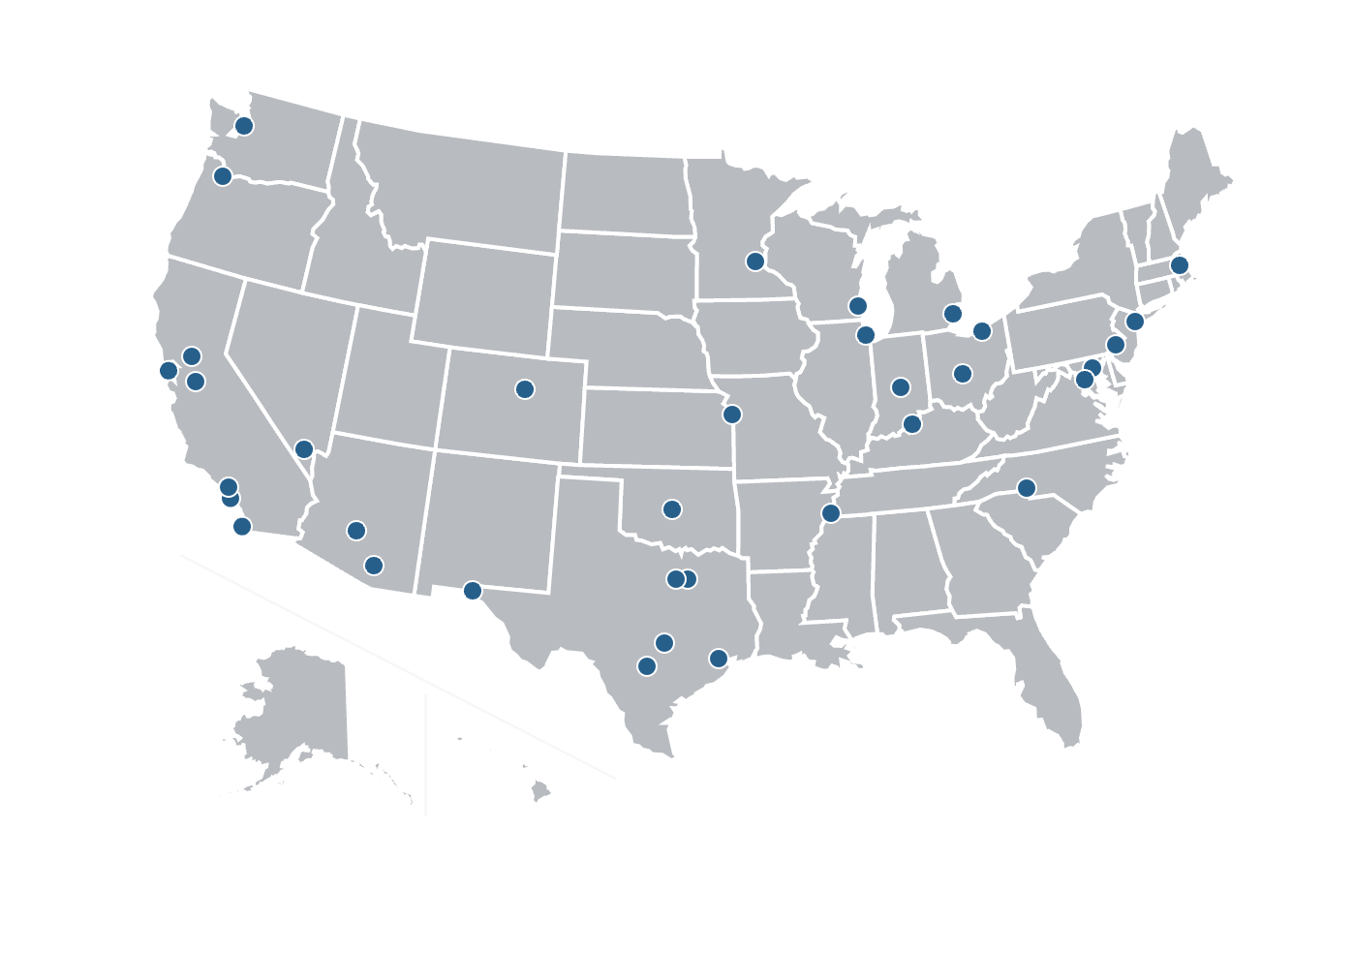
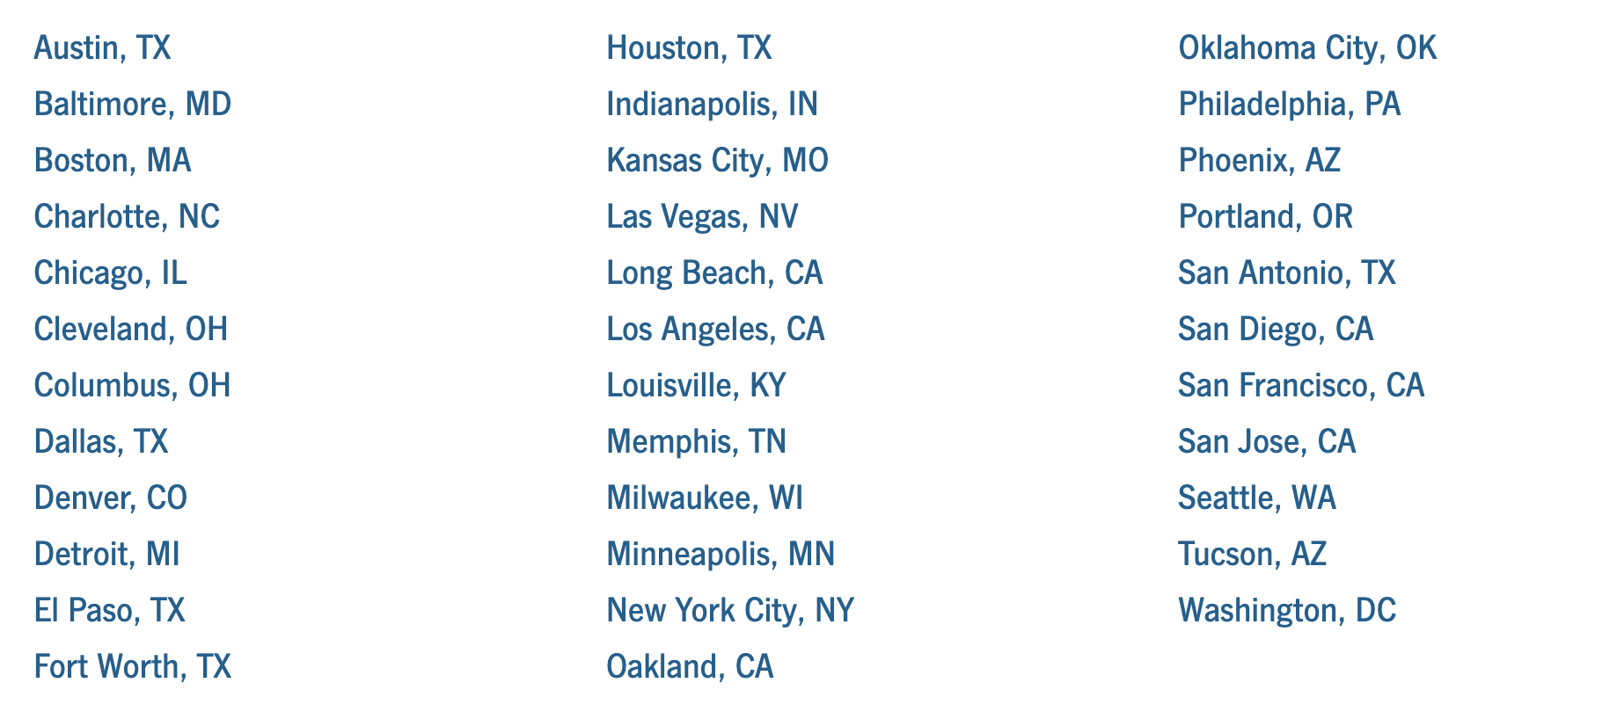
Methods pt. 1
Big Cities Health Inventory
Notes:
5 a. and 5.b
20 percent of our country’s population.

Slide 6

Methods pt. 2
Unemployment Rate
2019 ACS 1 Year Estimate of percent of civilian labor force unemployed
Change
Change in unemployment from 2019 – 2014
Population Density
Population per square mile
Per Capita Household Income
Segregation
Dissimilarity index between White and Non-White residents (0 = complete integration, 100 = complete segregation)
Minority Population
Percent of population that is nonwhite
Adult Mental Distress
Percent of adults (18+) with mental health not good for two weeks or more in previous 30 days
Notes:
5.c.

Slide 7
Methods pt.3
Originally planned on Poisson Regression using only change in unemployment percentage
Unemployment in all cities dropped from 2014 – 2019
LR test was significant
Concluded with a Negative Binomial Model
Used 2019 numbers and included change as additional covariate

Slide 8
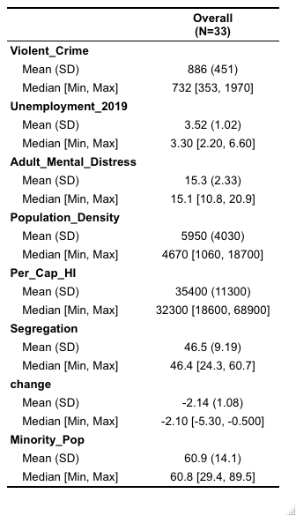
Table 1

Slide 9
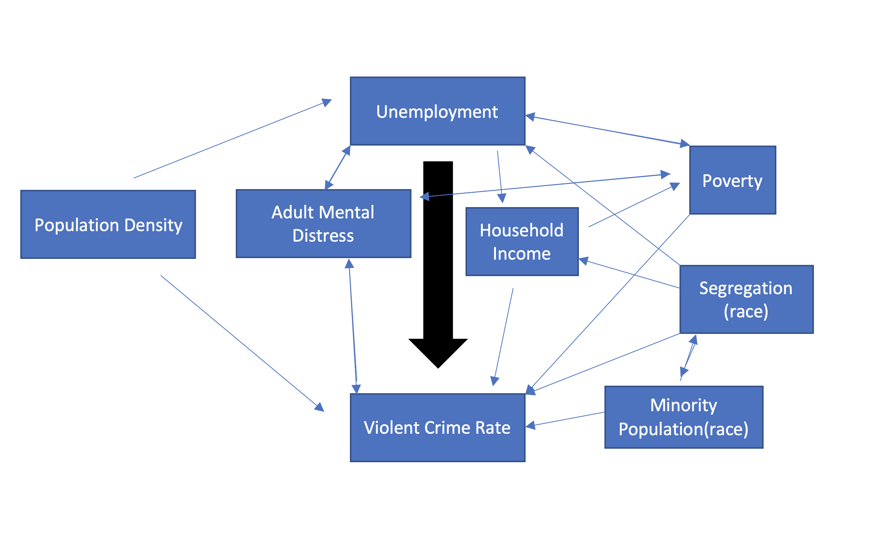

Slide 10
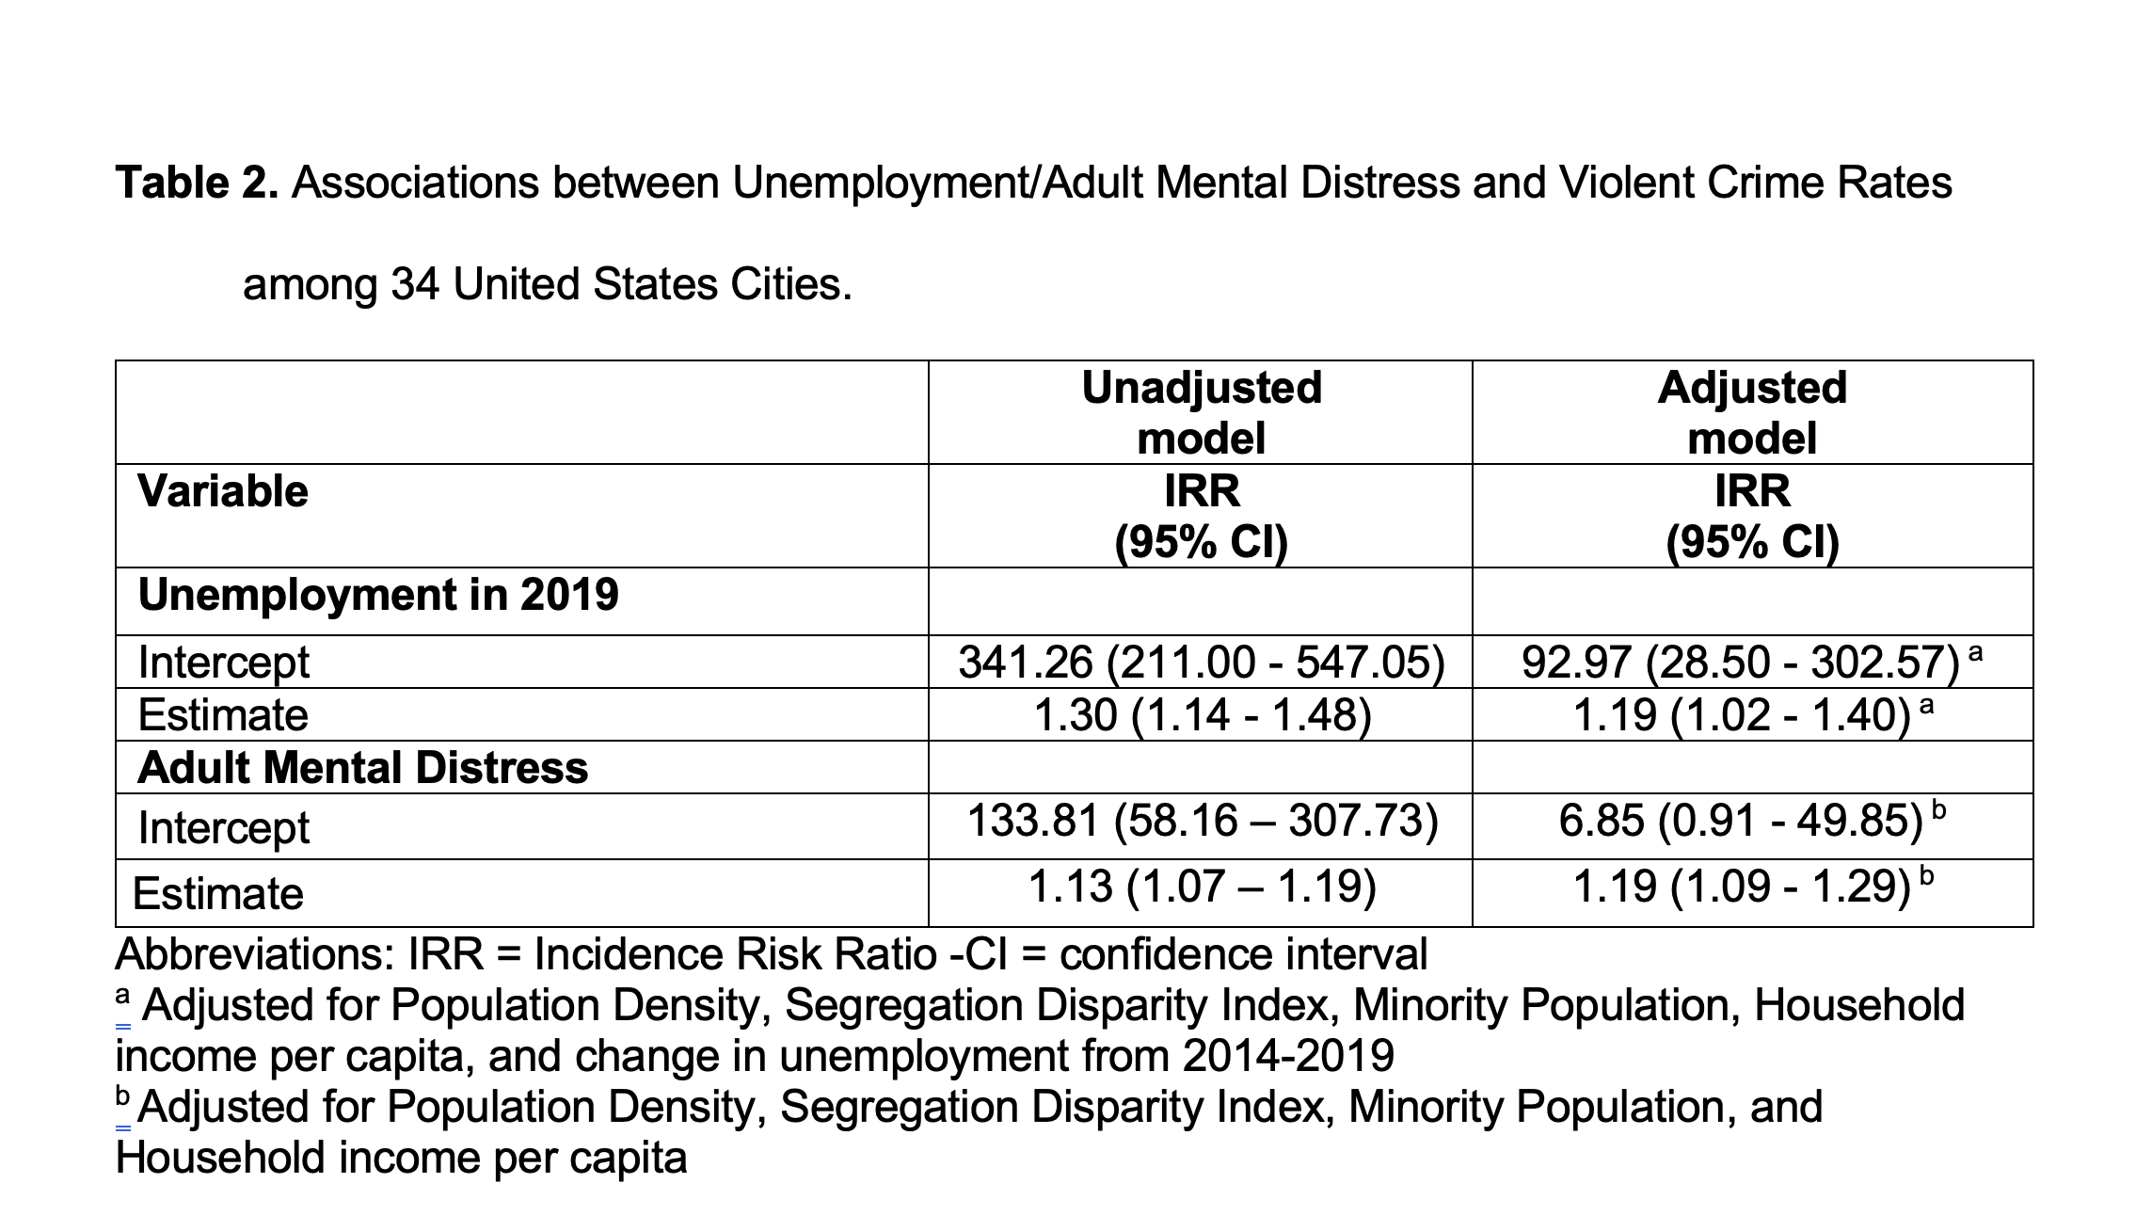

Slide 11
Summary
Primary Objective
For every additional percent increase in a cities unemployment the incidence rate of violent crime increased by 19% in our adjusted model
Secondary Objective
For every additional percent increase of number of adults experiencing mental distress the incidence rate of violent crime increased by 19% in our adjusted model

Slide 12
Consistency
Primary Objective: Unemployment
Yes
There are numerous studies worldwide that indicate a relationship between social factors and violent crime
Secondary Objective: Adult Mental Distress,
Yes
People with mental illness are disproportionately represented in our prison³
Often happens that folks with mental illness struggle navigating our confusing legal system³
Brazil Study²
Notes:
https://www.ncbi.nlm.nih.gov/books/NBK537064/

Slide 13
Strengths and Limitations
Strengths
Cities all-across the country
As local as most nationwide analysis can get
Not Covid Specific
Limitations
Sample Size
Crime is a local issue
Looks into long term change not specific policies

Slide 14
Takeaways
Upstream Solutions
Job Corps programs
Expanding Mental Health Services in Communities
Alternative Mental Distress Hotlines (988 number)

Slide 15
References
1. United States Federal Bureau Of Investigation. (2004) Uniform crime reporting handbook: UCR. [Washington, D.C.: U.S. Dept. of Justice, Federal Bureau of Investigation] [Web.] Retrieved from the Library of Congress, https://lccn.loc.gov/2004483104.
2. Britto DGC, Pinotti P, Sampaio B. The Effect of Job Loss and Unemployment Insurance on Crime in Brazil. Econometrica. 2022;90(4):1393-1423. doi:10.3982/ECTA18984
3. Ghiasi N, Azhar Y, Singh J. Psychiatric Illness And Criminality. StatPearls. January 2022.

